Slide 1
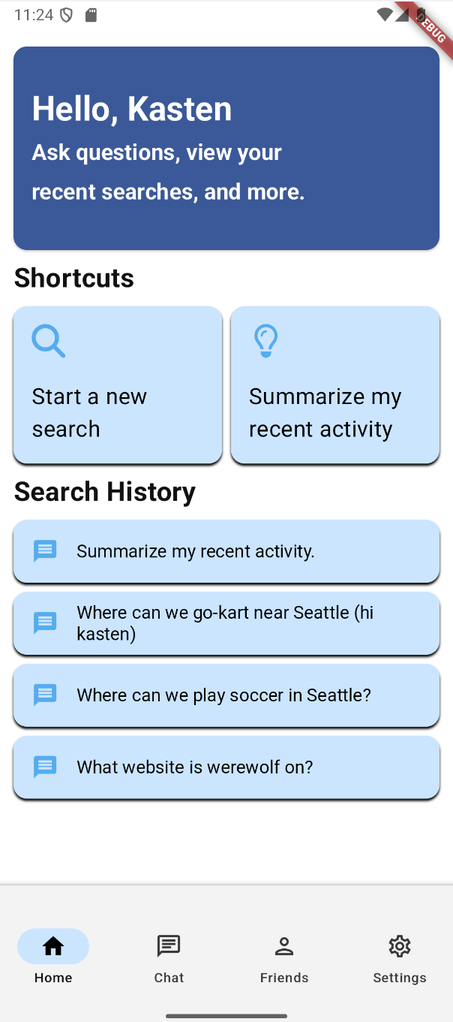
Message Summarization App
Krishna, Kasten, Richard

Slide 2

Motivation
Some messaging apps lack meaningful search functionality
  Among those that do, it’s not always helpful/effective
Idea: an app to consolidate messages from different platforms and provide reasonable, intelligent answers to user questions
Key tasks: analyzing context, retrieving relevant messages, summarization

Slide 3






Tech Stack

Slide 4
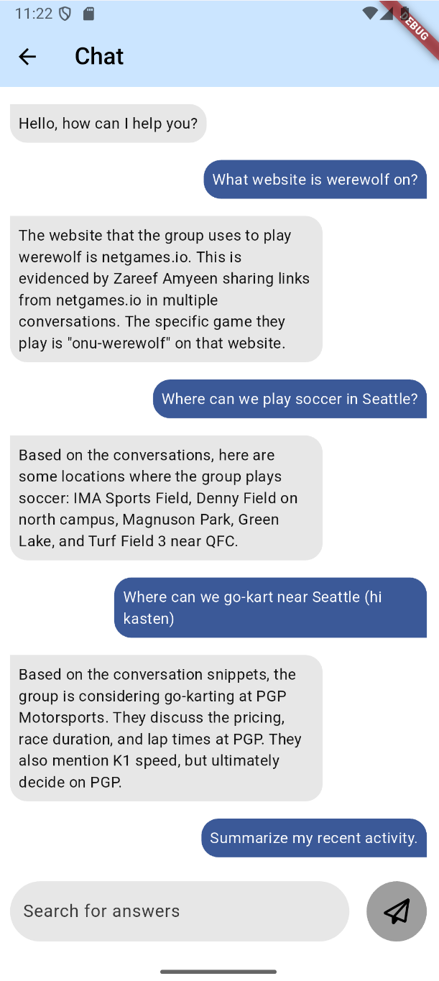
App Overview
Users search through past conversation history via chat agent
Summarize recent activity
Can try asking specific and general questions
Relative time-based queries
Add, delete, edit friend profiles
App settings (see demo…)
  Edit user profile
  Manage history
  About page :)
  …Appearance

Slide 5
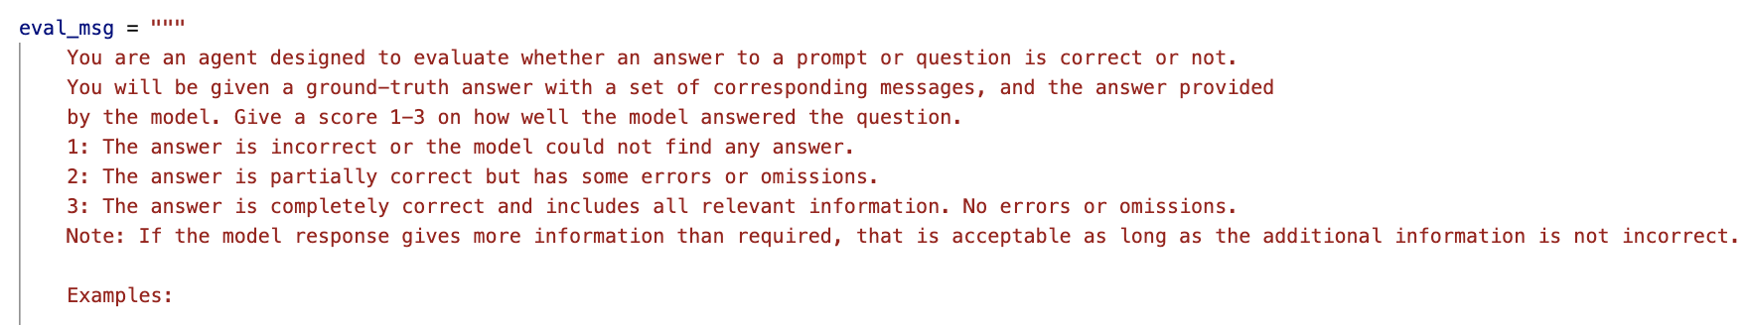
Evaluation Metrics
Evaluation Generation:
LLMs with structured output can be used to create a set of questions and answers to be used for evaluation
Evaluation is also done by a LLM
  Our model’s response, along with the question and ground-truth answer / supporting documents are fed into a LLM prompted with a rubric
Grading on a 1-3 scale
With dates:
  MultiQuery: 1.661764705882353
  Semantic Chunking: 1.411764705882353
No dates:
  MultiQuery: 1.7647058823529411
  Semantic Chunking: 1.5147058823529411
Needs larger context – summarize messages before to gather more context for evaluation

Slide 6
aaaAAAA demo VIDEO

Slide 7


Slide 8
Live Demo
Notes:
Notes: issues with last keyword, running queries that reference specific date

Slide 9
Big Takeaways
LLMs are the new neuron
Subtasks can be done by LLMs and and results can be passed to other LLM-powered subtasks via JSON formatting and LangChain/LangGraph
Semantic Chunking (RAG preprocessing technique) saves lives!
Create chunks of semantically similar messages and save their summary in a vector database
Designing aesthetically pleasing apps can be challenging
Managing state, layouts, navigation, and user interaction require careful planning
UwU

